Slide 1
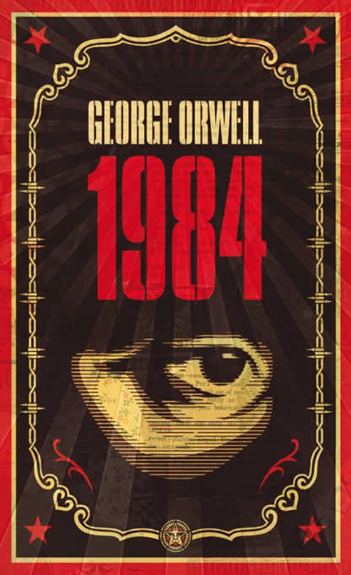
Nineteen Eighty Four by George Orwell

Slide 2
The author:
Born Eric Blair 1903, died George Orwell 1949.
Classical education at Eton - won scholarship
Worked as a Colonial Officer in Burma – resigned 1927
he hated authority
he hated injustice
‘I knew I had a facility with words and a power of facing unpleasant facts.’ The Hanging.

Slide 3
Nineteen Eighty Four is a satire (the use of humor, irony, exaggeration, or ridicule to expose and criticize people's stupidity or vices, particularly in the context of contemporary politics and other topical issues) on trends in international politics at the end of WW2.
Orwell’s intention is to draw attention to the oppression and cruelty as he saw in Nazi Germany, Soviet Russia, and even the behaviour of some Western countries.

Slide 4
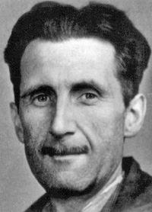
George Orwell
- considered himself a truth writer
- was a social reformer
- was involved in the Spanish civil war and found it far more complicated than he first imagined.
- said, “History is written by the winners.”

Slide 5
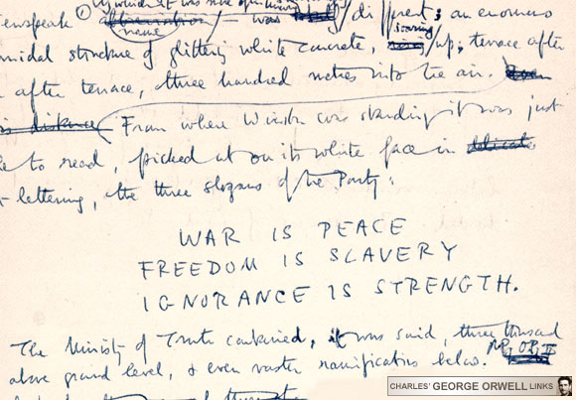
Slogans of “The Party”

Slide 6
Context of Nineteen Eighty-Four.
based on Soviet Russia and Nazi Germany.
Most details are from Nazi Germany.
Once a goal is reached in a totalitarian society it is replaced immediately by another.

Slide 7
Totalitarianism (or totalitarian rule) is a political system that strives to regulate nearly every aspect of public and private life. Totalitarian regimes or movements maintain themselves in political power by means of an official all-embracing ideology and propaganda disseminated through the state-controlled mass media, a single party that controls the state, control over the economy, regulation and restriction of free discussion and criticism, the use of mass surveillance, and widespread use of state terrorism.

Slide 8
As its name suggests, Totalitarianism is a political system that strives to regulate nearly every aspect of public and private life. Orwell’s Totalitarian society (Ingsoc) was aimless – “we are interested solely in power...if you want a picture of the future...imagine a boot stamping on a human face – for ever.” (O’Brien pg 280)

Slide 9
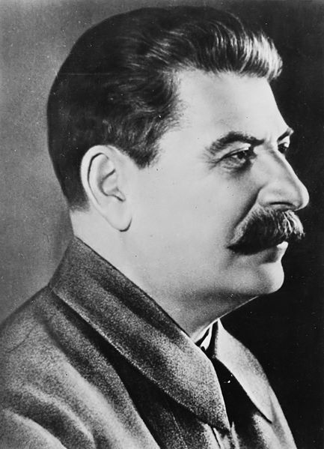
Joseph Stalin
(born Iosef Besarionis dze Jughashvili )
18 December 1878 – 5 March 1953)

Slide 10
Stalin was the General Secretary of the Communist Party of the Soviet Union's Central Committee from 1922 until his death in 1953. In the years following Lenin's death in 1924, he rose to become the leader of the Soviet Union.
.

Slide 11
Stalin launched a command economy, replacing the New Economic Policy of the 1920s with Five-Year Plans and launching a period of rapid industrialization and economic collectivization. The upheaval in the agricultural sector disrupted food production, resulting in widespread famine, such as the Soviet famine of 1932-1933, known in Ukraine as the Holodomor.

Slide 12
During the late 1930s, Stalin launched the Great Purge (also known as the "Great Terror"), a campaign to purge the Communist Party of people accused of corruption or treachery; he extended it to the military and other sectors of Soviet society. Targets were often executed, imprisoned in Gulag labour camps or exiled. In the years following, millions of ethnic minorities were also deported.

Slide 13
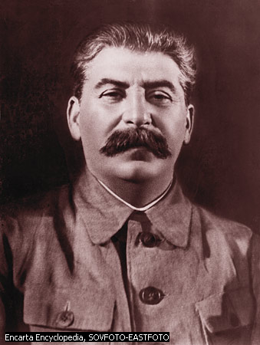
Big Brother is Watching YOU
The face of a man...with a heavy black moustache and ruggedly handsome features Pg 3, 1984

Slide 14
Background to Nineteen Eighty-Four
The world of Nineteen Eighty-Four is based upon two totalitarian dictatorships, Soviet Russia and Nazi Germany.
The world of Ingsoc (English socialism) bears strong resemblances to the Soviet Union, but much of the details are based on Nazi Germany.

Slide 15
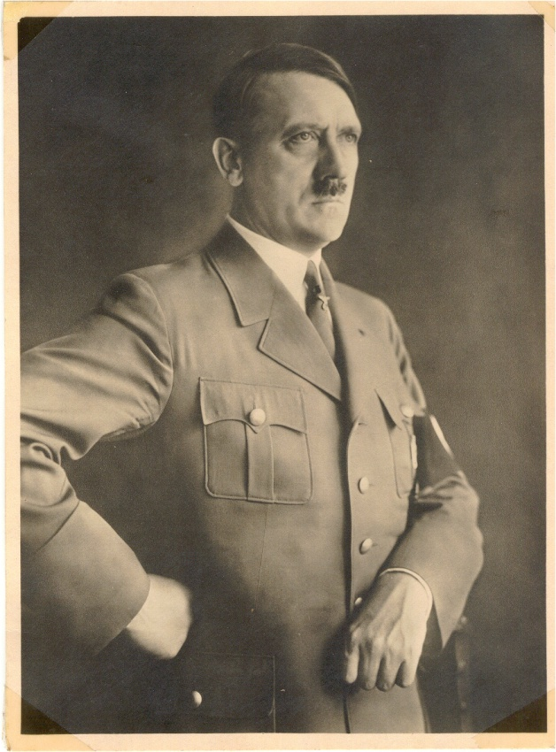
Nazi Germany
EVER since I have been scrutinizing political events, I have taken a tremendous interest in propagandist activity. I saw that the Socialist-Marxist organizations mastered and applied this instrument with astounding skill. And I soon realized that the correct use of propaganda is a true art which has remained practically unknown to the bourgeois parties.
Mein Kampf by Adolf Hitler Volume One - A Reckoning

Slide 16
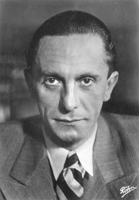
We do not intend to use the radio only for our partisan purposes. We want room for entertainment, popular arts, games, jokes and music. But everything should have a relationship to our day. Everything should include the theme of our great reconstructive work, or at least not stand in its way. Above all it is necessary to clearly centralize all radio activities, to place spiritual tasks ahead of technical ones, to introduce the leadership principle, to provide a clear worldview, and to present this worldview in flexible ways.
- Goebbels

Slide 17
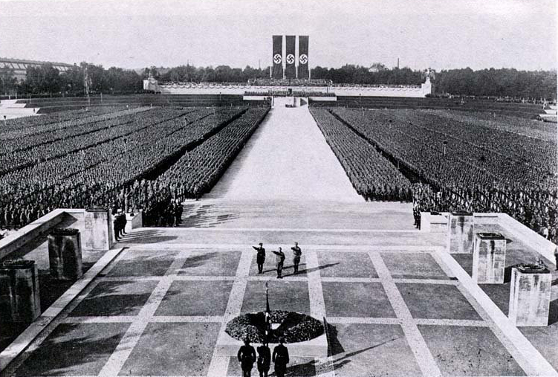

Slide 18
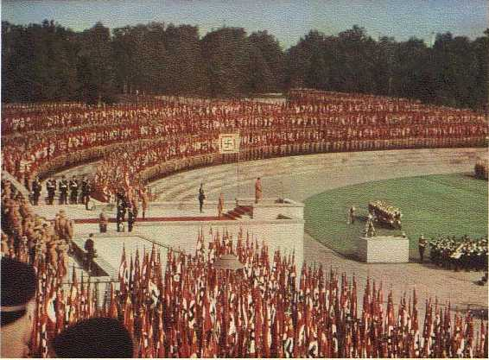

Slide 19
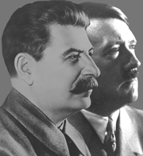
Like Stalin, Adolph Hitler denied his subjects access to the truth. His Third Reich “can be read as a war against memory – an Orwellian falsification of reality...” (Primo Levi) Oceania conducts an unceasing war on memory-evidence that conflicts with the latest official line is systematically destroyed & a false trail is laid in its place.

Slide 20
Surveillance and control
The people of this society are constantly being watched by telescreens (monitors that have an ability to project images and take in images)
They are also watching each other. Any small facial gesture or sigh can give you away.
It doesn’t matter if you are innocent

Slide 21
Big Brother is Watching
YOU
!

Slide 22
Children of the revolution
In the Soviet Union, young people were encouraged to join the political group. They were called Young Pioneers (aged between 7-13).
If you were a Young Pioneer member you got into university automatically, so there was great pressure to join.

Slide 23
Hitler Youth
"My teaching is hard. Weakness has to be knocked out of them. In my Ordensburgen a youth will grow up before which the world will shrink back. A violently active dominating, intrepid, brutal youth - that is what I am after". Youth must be all those things. It must be indifferent to pain. There must be no weakness or tenderness in it. I want to see once more in its eyes the gleam of pride and independence of the beast of prey. "I will have no intellectual training. Knowledge is ruin to my young men.

Slide 25
What does this remind you of?
“How easy it was, thought Winston, if you did not look about you, to believe that the physical type set up by the Party as an ideal, - tall muscular youths and deep bosomed maidens, blond haired, vital, sunburnt, carefree –existed and even predominated”
Nineteen Eighty-Four (p63).

Slide 26
Some themes…
The lack of privacy
The dangers of totalitarianism
The destruction of history.
The essential nature of memory.
An appreciation of the past.
The ultimate unreliability of the human mind/memory
Technology and Modernization
The use of language
Rebellion

Slide 27
Oceania –
One of the 3 Superstates. (Political System: Ingsoc) Winston Smith's home. Comprised of North and South America, Britain, Australia, and southern portions of Africa. Newspeak is the official language of Oceania, but standard English is still spoken by many.

Slide 28
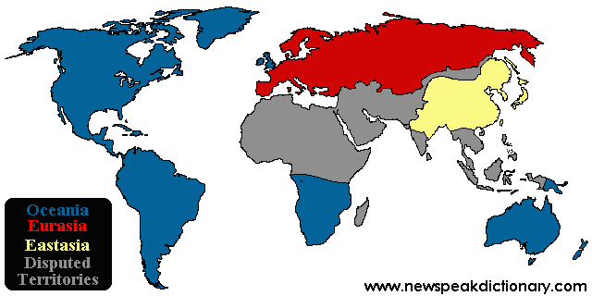
The Three Superstates

Slide 29
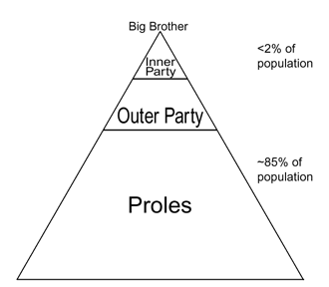

Slide 30
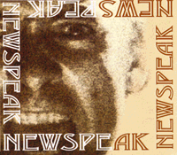
Newspeak
Newspeak, the "official language" of Oceania, is extraordinary in that its vocabulary decreases every year; the state of Oceania sees no purpose in maintaining a complex language, and so Newspeak is a language dedicated to the "destruction of words." As the character Syme puts it:

Slide 31
"Of course the great wastage is in the verbs and adjectives, but there are hundreds of nouns that can be got rid of as well... If you have a word like 'good', what need is there for a word like 'bad'? 'Ungood' will do just as well... Or again, if you want a stronger version of 'good', what sense is there in having a whole string of vague useless words like 'excellent' and 'splendid' and all the rest of them? 'Plusgood' covers the meaning, or 'doubleplusgood' if you want something stronger still.... In the end the whole notion of goodness and badness will be covered by only six words; in reality, only one word."
(Part One, Chapter Five)

